Slide 1



Creating positive work environments for mental wellbeing – the what, why and how

Slide 2
Karakia
Whakataka te hau ki te uru,
Whakataka te hau ki te tonga.
Kia mākinakina ki uta,
Kia mātaratara ki tai.
E hī ake ana te atākura,
He tio, he huka, he hauhunga.
Haumi e! Hui e! Tāiki e!
Get ready for the westerly
and be prepared for the southerly.
It will be icy-cold inland,
and icy-cold on the shore.
May the dawn rise red-tipped on ice,
on snow, on frost.
Join! Gather! Intertwine!

Slide 3
What you will get out of today
Understand
  mental health and wellbeing
  why it’s important to think about wellbeing at work
Learn
  how to create a positive work environment
  some practical things that you can do
  Is there anything else someone wants to learn today?

Slide 4
What is mental health and wellbeing?
A state of wellbeing where people can reach their potential, cope with normal stressors, can work productively and contribute to community (WHO 2014)
Aspects of work that harm or impair mental wellbeing are commonly referred to as psychosocial risks, but it may be more helpful to refer to psychosocial risks simply as risks to mental wellbeing.

Slide 5
Poor mental wellbeing
Costly to both individuals and organisations
Acute or chronic
Result from a single or repeated exposure to risk(s) factors
Impact can be mild to severe psychological disorders e.g., depression, anxiety

Slide 6
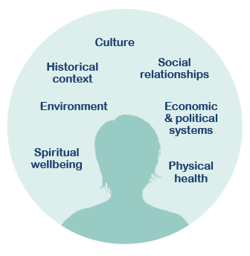
Mental health and mental wellbeing

Slide 7


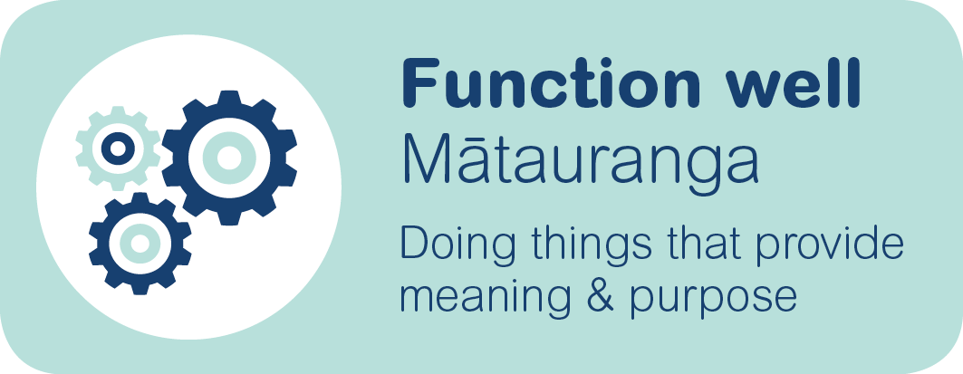

What we want for our workers

Slide 8
The statistics
It is estimated that mental health problems cost New Zealand businesses at least $1.65bn per annum
The WorkSafe Segmentation and Insights Programme Research (2019) found that in the last 12 months, 20% of respondents experienced depression, 31% anxiety, and 60% stress
The New Zealand Workplace Barometer (2020) reported that 70% of respondents reported an absence from work during the last 12 months due to ‘physical or mental health’

Slide 9
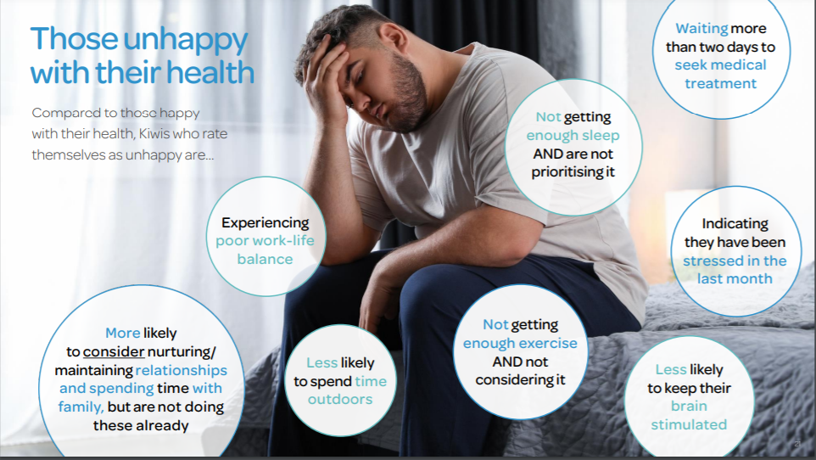
Notes:
Source: Southern Cross Healthy Futures Report 2020

Slide 10
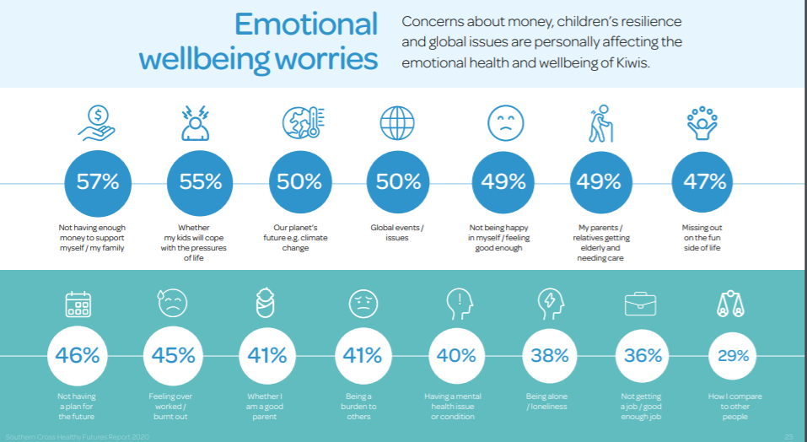

Slide 11
The business case: Te tangata, te tangata
Improved recruitment and retention
Fewer disruptions impacting your organisations
Enhanced reputation
Decreased unplanned leave
Decreased presenteeism
Increased productivity and improved customer service
Knowledge, skills and experience are of little use without energy
HSWA 2015, ERA 2000, Human Rights Act 1993

Slide 12





Creating positive work environments

Slide 13
Key elements for creating positive work environments
LEADERSHIP
CULTURE
P
E
R
F
O
R
M
A
N
C
E
Leadership commitment
Policies and processes
Effective communication
Evaluating and reviewing

Slide 14
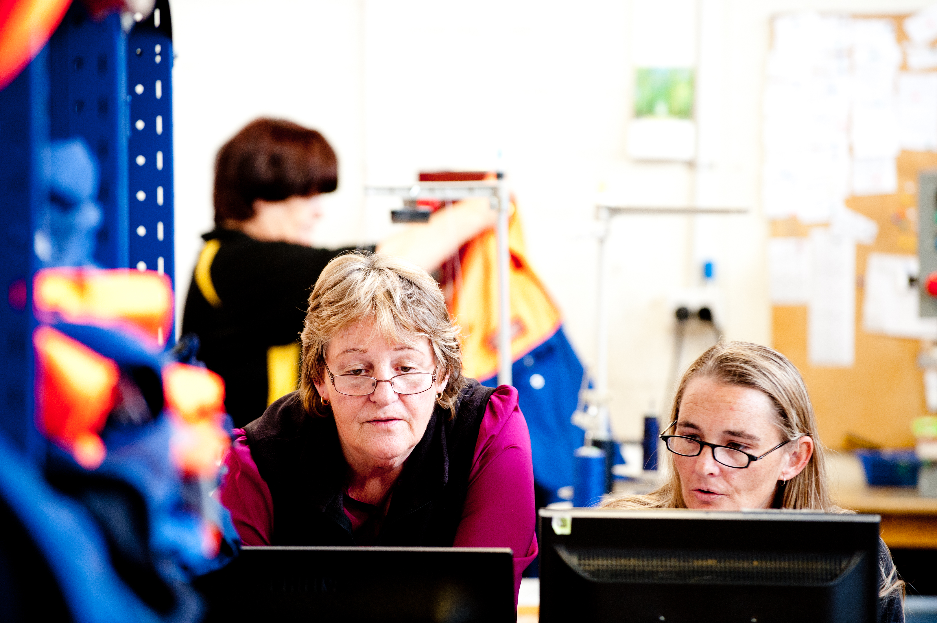
1. Leadership commitment
Communicate policies
and objectives
Model mentally-healthy
behaviours and values
Engage with the team

Slide 15
2. Policies and processes
Policies and processes should support people to work, and should be reviewed on a regular basis to ensure they are fit for purpose.
How does each policy impact mental wellbeing?
  Is it safe? Creating a psychologically-safe workplace
  Is it supportive? Pro-active, fair and empathetic
  Will it strengthen wellbeing? Encourage workers to engage?
How does this policy reflect your workplace values?
How are risks to mental wellbeing identified and managed?
Are your people a strategic asset, with the knowledge that they are contributing to the purpose and values of the organisation?

Slide 16
New tools – the design of mentally-healthy work
Business leaders' health and safety forum
CEO's guide to mental health and wellbeing at work, and protecting mental wellbeing at work guide for CEOs
  https://forum.org.nz/resources/
Vaccination policy support
  https://forum.org.nz/resources/vaccination/
ISO 45003
Occupational health and safety management – psychological health and safety at work guidelines for managing psychosocial risks
  https://www.iso.org/obp/ui/#iso:std:iso:45003:ed-1:v1:en

Slide 17
3. Effective communication
Ensure messages are relevant and transparent, clear and consistent
Messages should strike a balance, cut through the noise
Two-way communication using a variety of mediums
Team discussions
One-on-one discussions
Conversations when someone is struggling

Slide 18
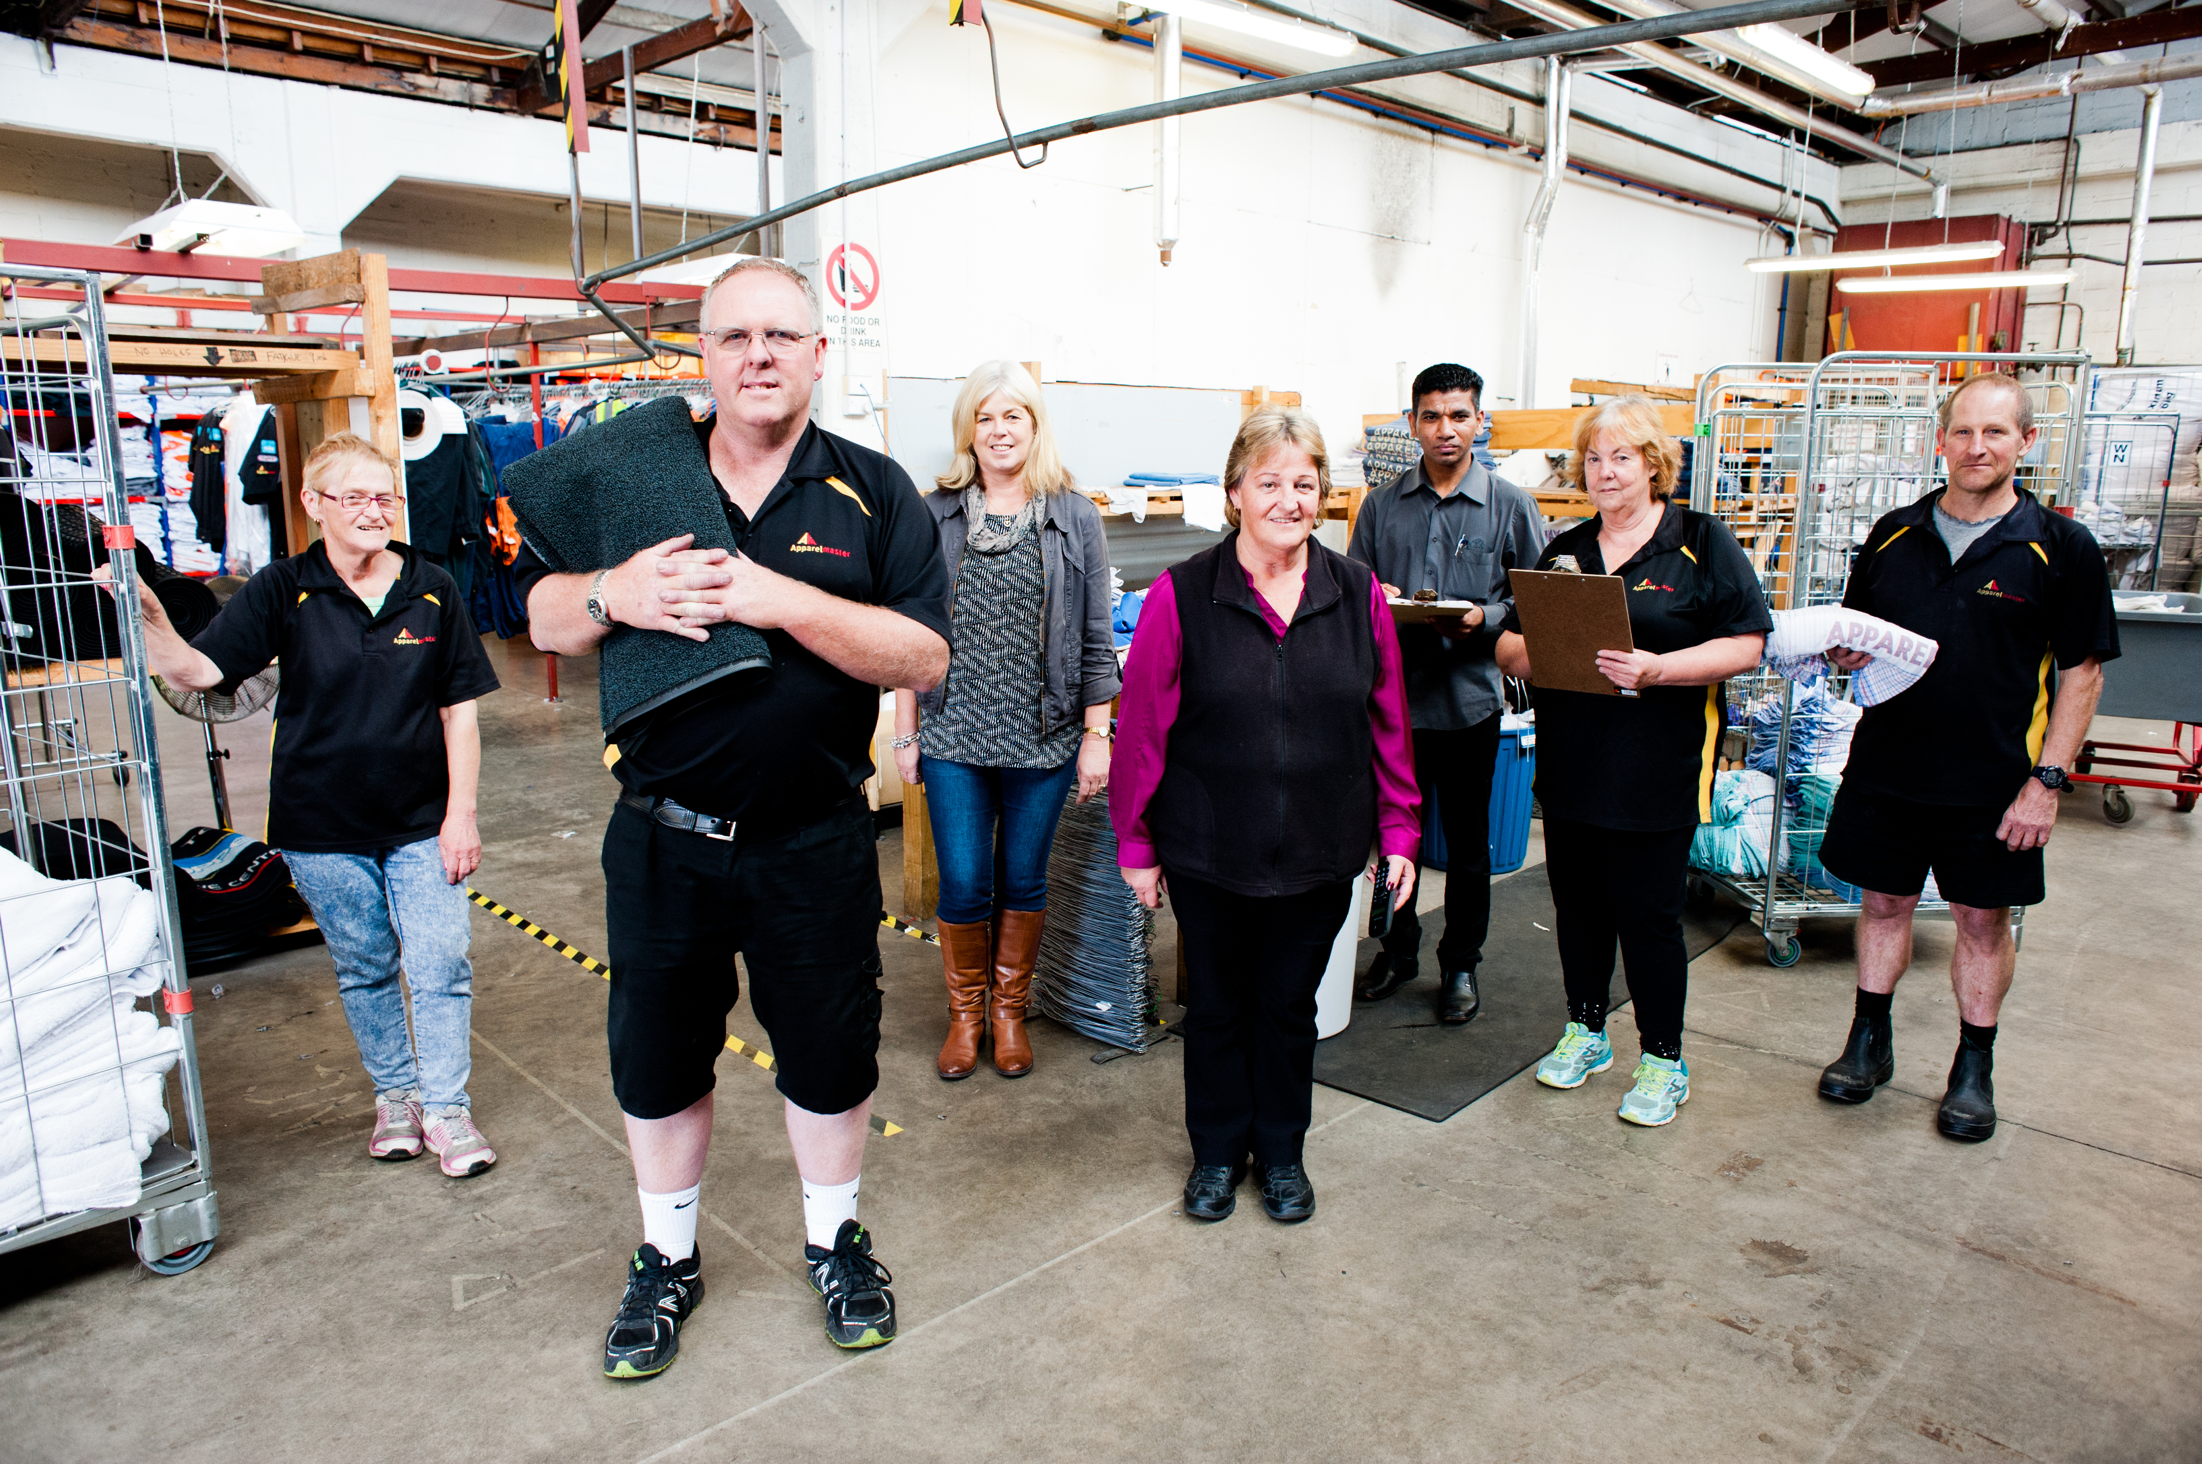
Team discussions

Slide 19
Teams
Know your team members, and their strengths and weaknesses as individuals and in teams
If you're working in a hybrid or WFH situation, have a routine, check-ins and de-briefs
Make wellbeing conversations part of the normal check-in process
Ensure expectations of the team and ourselves are reasonable
Create a sense of control, hope and fun
Team building

Slide 20
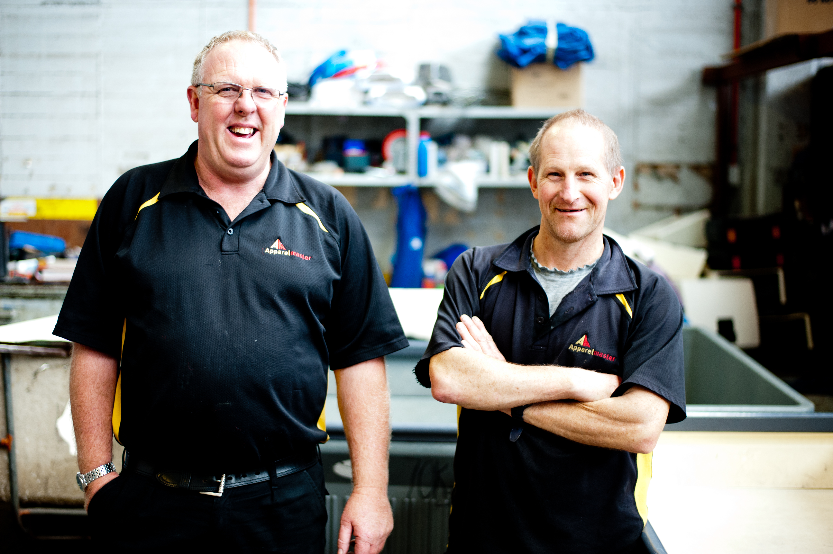
One-on-one

Slide 21
1-1 conversations
Practice everyday conversations – how are you today, what’s important to you today, what supports are in place, what barriers?
If you become great at having everyday conversations, then when someone is struggling it's going to be easier to talk about it.

Slide 22
The Covid-19 conversation
Be aware of and manage your emotions, tone, speed, body language
Be non-judgemental
Ask questions, don’t make assumptions
Listen, and try and understand
Empathise and use affirmations
Distinguish between vaccine-hesitant and anti-vaccination stances
Focus on what you can agree on
When you do/don’t do xyz it makes me feel unsafe, to feel safe I need …

Slide 23
Conversations when someone might be struggling
What might you notice?
- Change in behaviour, emotions, thoughts, reactions
What could you do?
Ask
Listen
Help, repeat

Slide 24
How could you start the conversation?
Some tips:
Consider the conversation's time and place
Talk about the behaviour or change
Reassure them, and be non-judgemental
Ask questions, don’t make assumptions
Listen, and try to understand
Empathise
Help them to make a plan about what to do next
Check back in later

Slide 25
4. Evaluating and reviewing
KISS – Keep it simple, sweetie!
ASK staff
  One-on-ones
  Team meetings
  Staff surveys
Re-visit plans regularly
It is about starting, and then continually improving

Slide 26
Reviewing workshop goals
Understand
  mental health and wellbeing
  why it’s important to think about wellbeing at work
Learn
  how to create a positive work environment
  some practical things that you can do

Slide 27
What our workplace offers
Add in your local supports and services, e.g.,
  Employee Assistance Programmes
  Key staff contacts
  Local health and wellbeing providers
  You can get an updated list of helplines and local mental health services (https://mentalhealth.org.nz/helplines) - this has space to add your local numbers as well
  https://covid19.govt.nz/

Slide 28
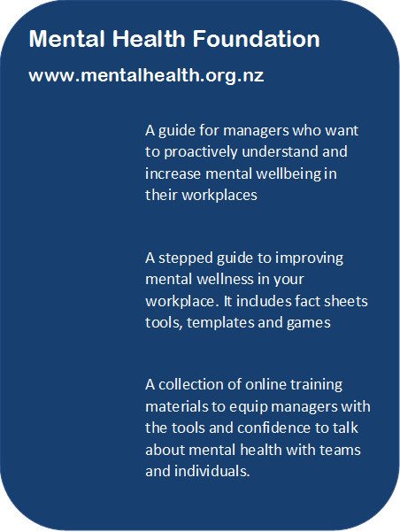

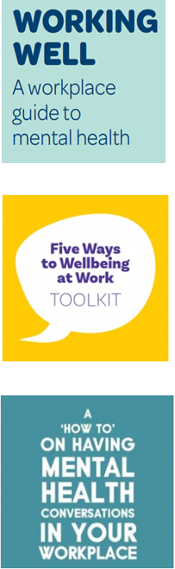




Slide 29
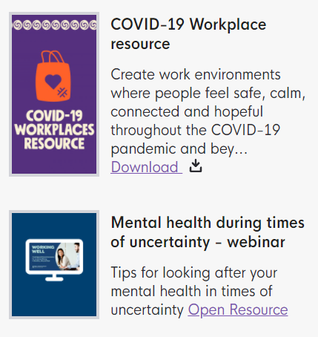
Mental Health Foundation Covid-19 resources
https://mentalhealth.org.nz/search?query=covid

Slide 30
Karakia
Kia whakairia te tapu
Kia wātea ai te ara
Kia turuki whakataha ai
Kia turuki whakataha ai
Haumi e. Hui e. Tāiki e!
Restrictions are moved aside
So the pathway is clear
To return to everyday activities

Slide 31

Creating positive environments for mental wellbeing
– the what, why and how

