Slide 1



Slide 2
How to play
The purpose of this activity is to get to know your hoamahi (workmates) better this Pink Shirt Day. When we get to know each other as whole people and not just as job roles, we develop respect and trust.
Put this PowerPoint into Slide Show mode (F5 or click the Start Slide Show button)
Click the centre of the kōrero-starter wheel to spin
Click the centre again to stop
Go to the selected question by clicking on the index table
If you’re in a small group (<5), take turns to answer the question
If you’re in a larger group, break into smaller groups (you can use the Break Out Rooms function if you’re on a Teams call)
Click Back to return to the wheel and repeat steps 2-6

Slide 3
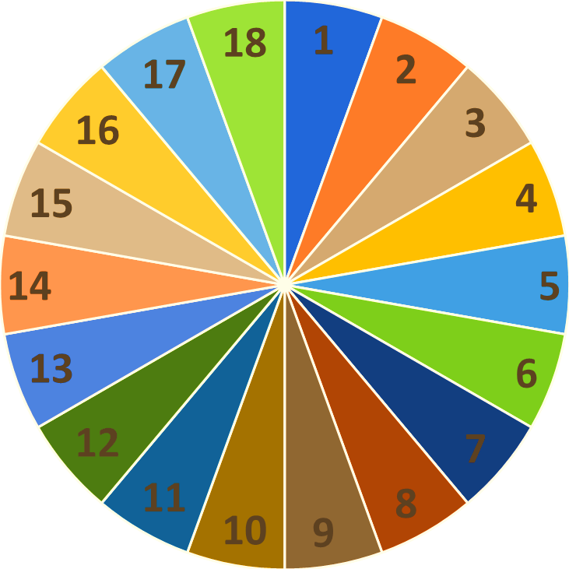
Spin the kōrero-starter wheel
Question Index
Q. 1 | Q.2 | Q.3
Q.4 | Q.5 | Q.6
Q.7 | Q.8 | Q.9
Q.10 | Q.11 | Q.12
Q.13 | Q.14 | Q.15
Q.16 | Q.17 | Q.18

Slide 4

1.1

Slide 5

2.1

Slide 6

3.1

Slide 7

4.1

Slide 8

5.1

Slide 9
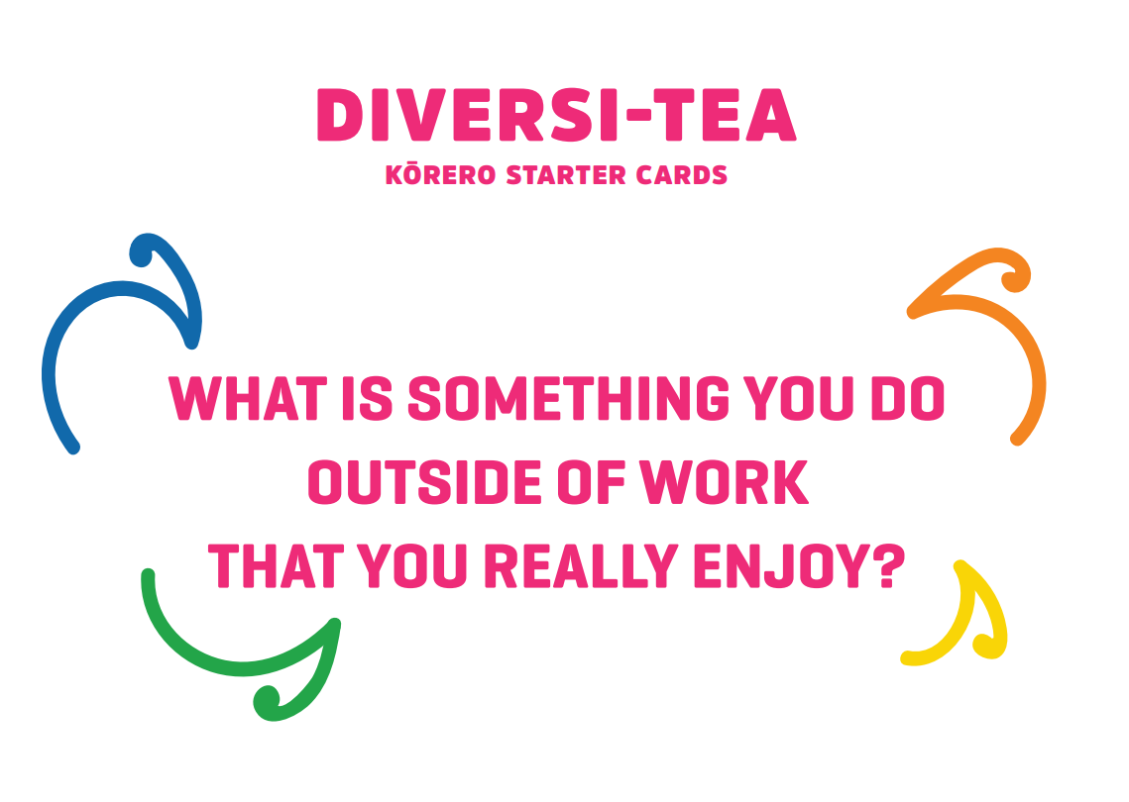
6.1

Slide 10
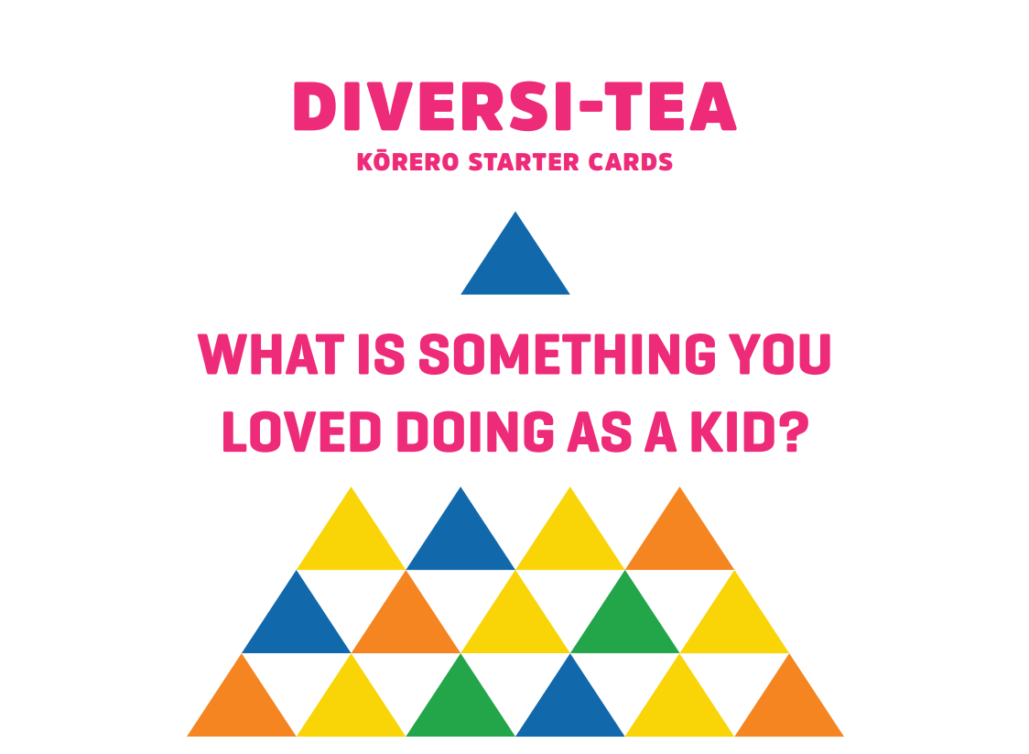
7.1

Slide 11
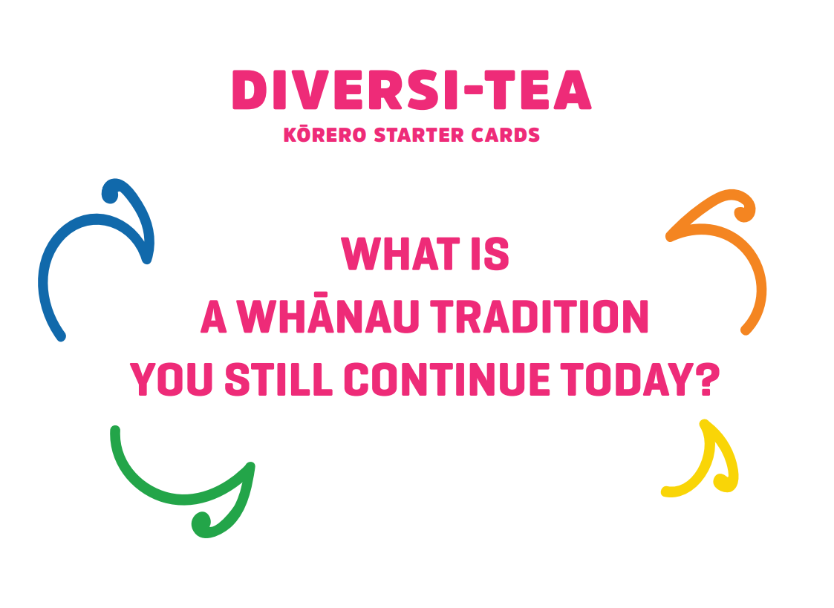
8.1

Slide 12

9.1

Slide 13

10.1

Slide 14

11.1

Slide 15

12.1

Slide 16

13.1

Slide 17

14.1

Slide 18

15.1

Slide 19

16.1

Slide 20

17.1

Slide 21
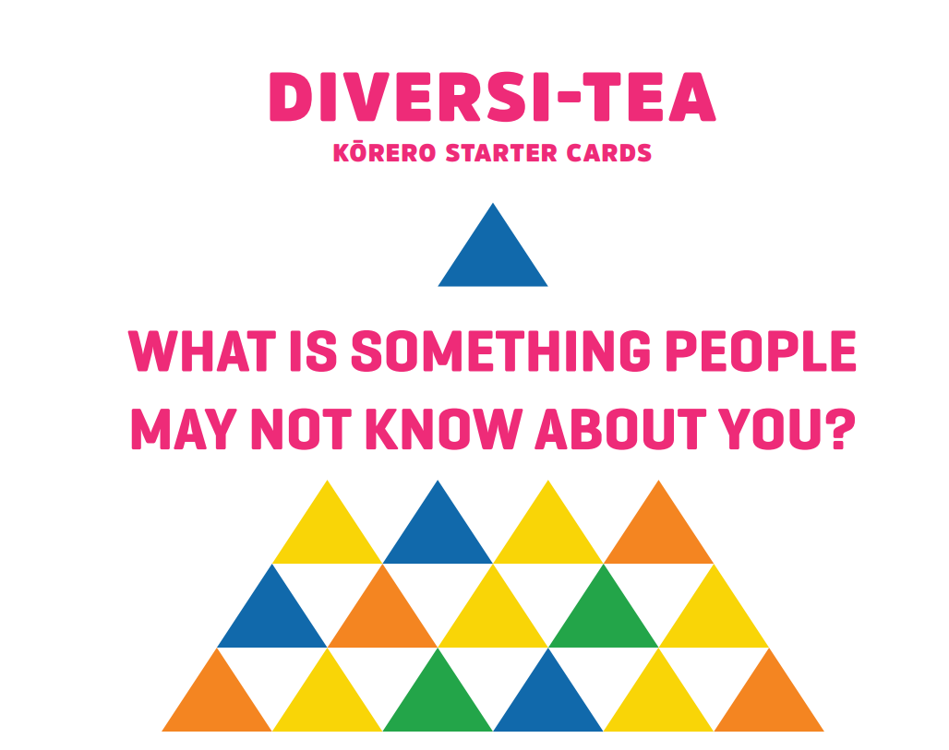
18.1

