Slide 1
Creating positive environments for mental wellbeing
– the what, why and how

Slide 2
Karakia
Whakataka te hau ki te uru, Whakataka te hau ki te tonga. Kia mākinakina ki uta, Kia mātaratara ki tai. E hī ake ana te atākura he tio, he huka, he hauhunga. Haumi e! Hui e! Tāiki e!
Get ready for the westerly and be prepared for the southerly. It will be icy cold inland, and icy cold on the shore. May the dawn rise red-tipped on ice, on snow, on frost. Join! Gather! Intertwine!

Slide 3
What you will get out of today
Understand
mental health and wellbeing
why it’s important to think about wellbeing at work
Learn
how to create an positive work environment
some practical things that you can do

Slide 4
What is mental wellbeing and what is a positive environment?
What is mental wellbeing?
What is one thing that can help to create a positive work environment?

Slide 5
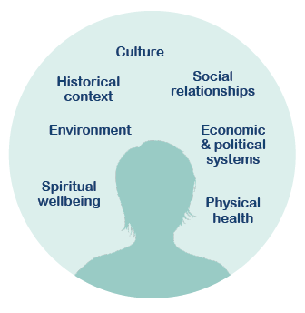
Mental health and mental wellbeing

Slide 6
What we’re aiming for

Slide 7
The business case
Mental health problems are common
1 in 2 New Zealanders in their lifetimes
Workplace wellbeing programmes save money
$4.20 for every $1 Spent
It’s the law

Slide 8
Positive work environments

Slide 9
Key elements for creating positive environments
Leadership commitment
Encourage communication
Policy and processes
Evaluating and reviewing

Slide 10
Leadership commitment
Communicate
Model
Engage

Slide 11
Encourage communication around mental wellbeing
One-on-one discussions
Team discussions
Conversations when someone is struggling

Slide 12
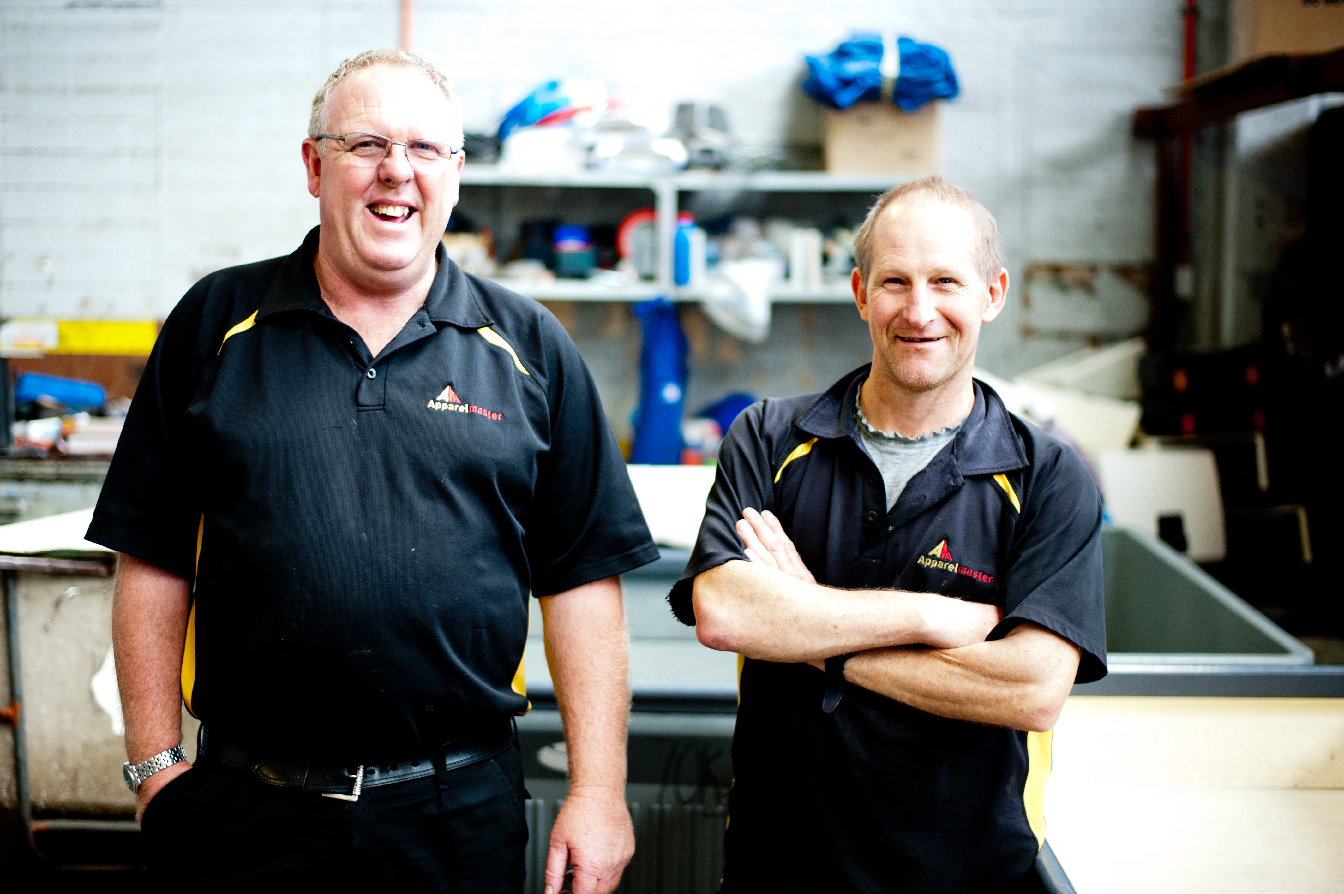
One-on-one discussions

Slide 13
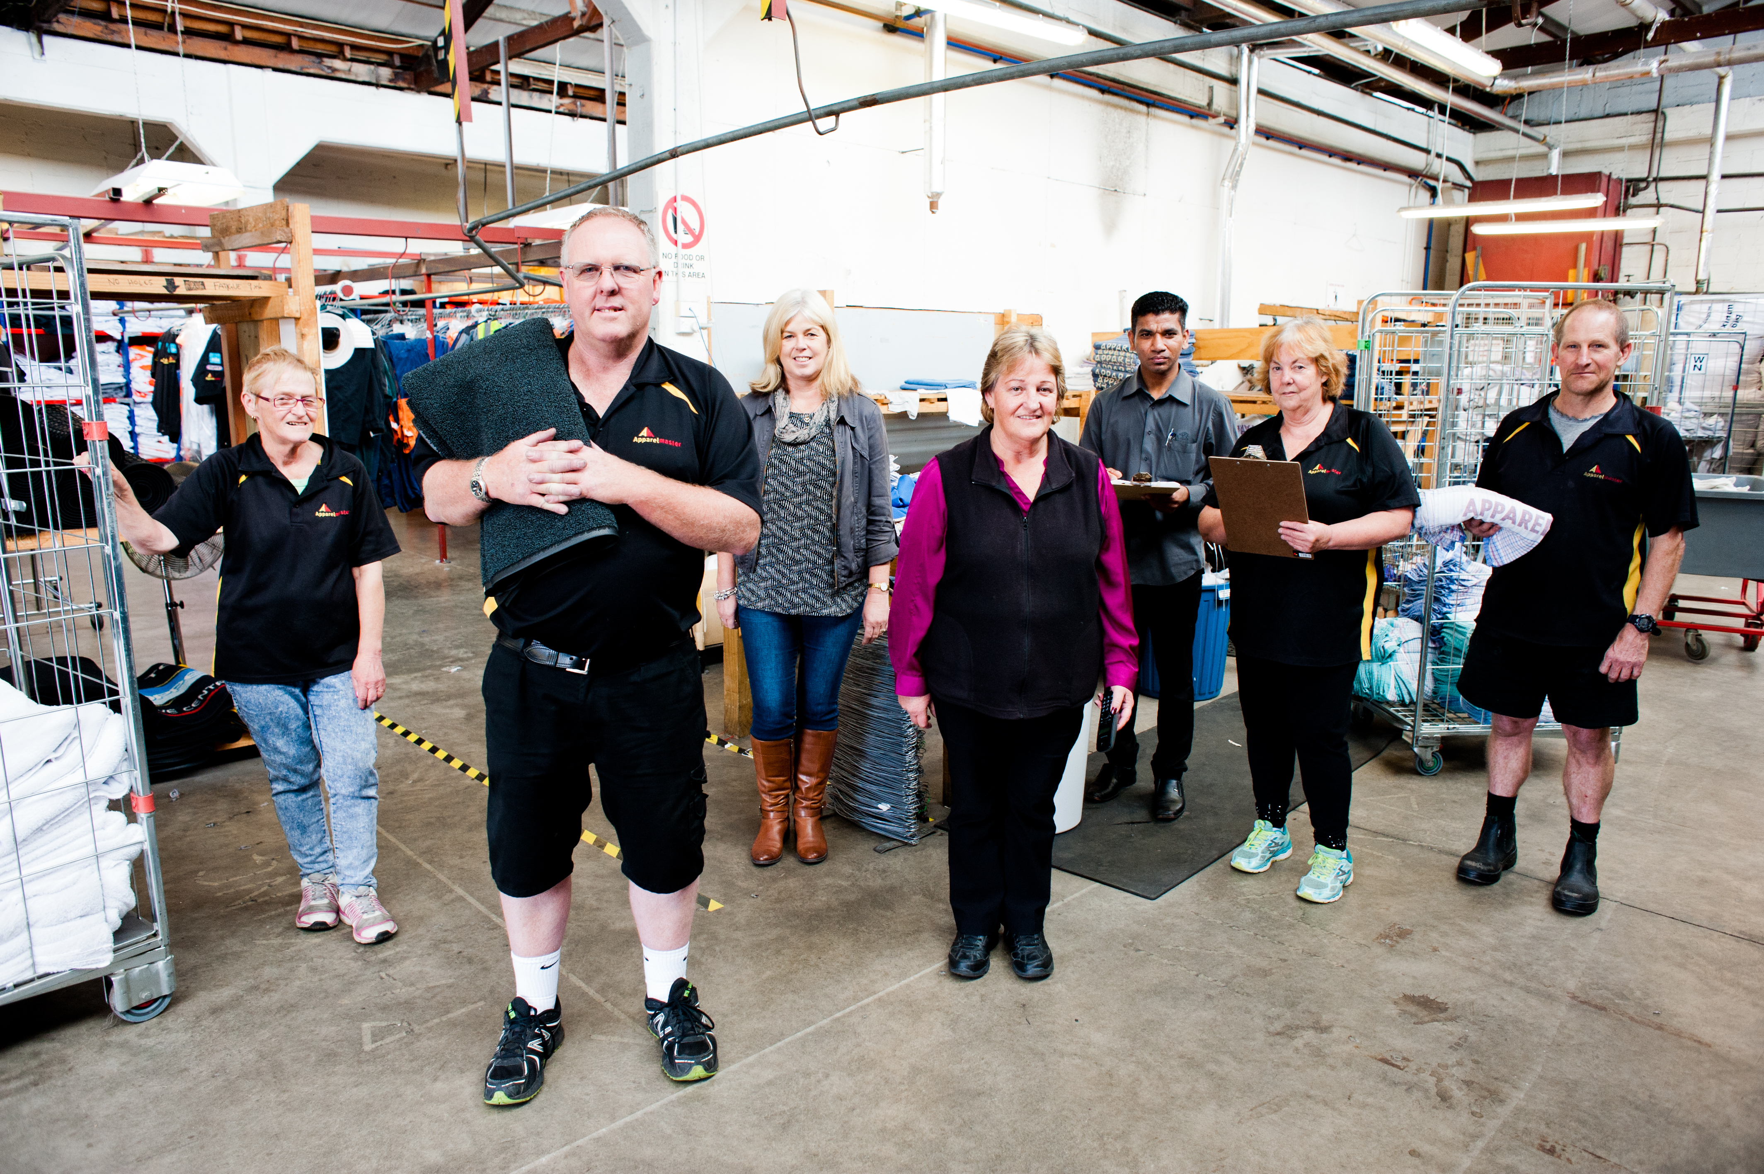
Team discussions

Slide 14
Conversations when someone might be struggling
What might you notice?
- Change
What could you do?
- Ask

Slide 15
How could you start the conversation?
Some tips:
Time and place
Talk about the behaviour or change
Reassure & be non-judgemental
Ask questions, don’t make assumptions
Listen and try to understand
Empathise
Help them make a plan about what to do next
Check back later

Slide 16
Policy and processes to support mental wellbeing
When assessing need and identifying priorities, ask:
How does this impact mental wellbeing?
Is it safe?
Is it supportive?
Will it strengthen wellbeing?

Slide 17
Evaluating and reviewing
KISS – Keep it simple sweetie!
ASK staff
One on ones
Team meetings
Staff surveys
Revisit plans regularly

Slide 18
Reviewing workshop goals
Understand
mental health and wellbeing
why it’s important to think about wellbeing at work
Learn
how to create a positive work environment
some practical things that you can do

Slide 19
What our workplace offers
Add in your local supports and services e.g.
Employee Assistance Programmes
Key staff contacts
Local health and wellbeing providers
You can get an updated list of Helplines and local mental health services (https://www.mentalhealth.org.nz/assets/Helplines-and-local-mental-health-services/MHF-Helplines-A4-WEB-FINAL.pdf ) - this has space to add your local numbers as well

Slide 20
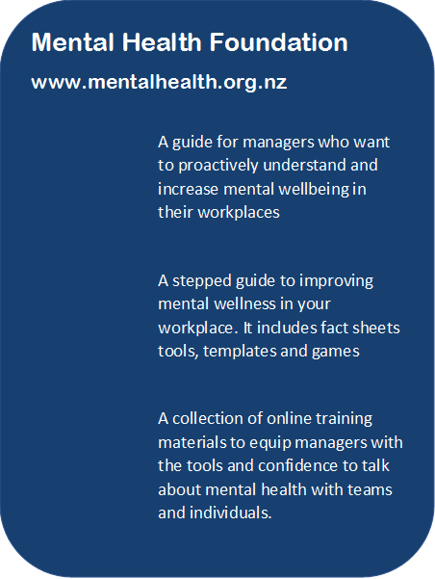

Slide 21
Karakia
Kia whakairia te tapu
Kia wātea ai te ara
Kia turuki whakataha ai
Kia turuki whakataha ai
Haumi e. Hui e. Tāiki e!
Restrictions are moved aside
So the pathway is clear
To return to everyday activities

Slide 22
Creating positive environments for mental wellbeing
– the what, why and how

