Slide 1






Kōrero card set activity
COMMUNITY IS...
WHAT WE CREATE
How do you take a
moment to check-in
with yourself?
He aha tāu mahi hei
whakatau i a koe anō?
together.
mhaw.nz
23–29 Sept
mhaw.nz

Slide 2
Spin the kōrero wheel
The purpose of this activity is to get to know the MHAW theme and your hoamahi (workmates) better.
  Put this PowerPoint into Slide Show mode (F5 or click the Start Slide Show button)
  Click the ‘Spin the kōrero wheel’ button to spin
  Click the button again to stop
  Go to the selected question by clicking on the index table
  If you’re in a small group (less than 5), take turns to answer the question
  If you’re in a larger group, break into smaller groups to answer the question
  Click Back to return to the wheel and repeat steps 2-6

Slide 3
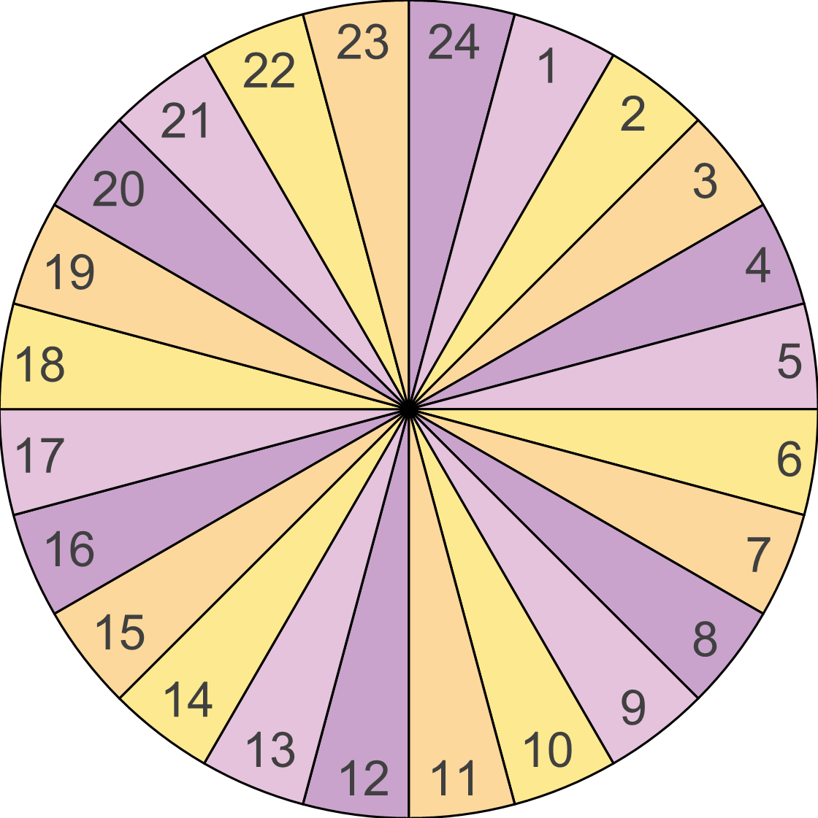
Question index
Q1 | Q13
Q2 | Q14
Q3 | Q15
Q4 | Q16
Q5 | Q17
Q6 | Q18
Q7 | Q19
Q8 | Q20
Q9 | Q21
Q10 | Q22
Q11 | Q23
Q12 | Q24
Spin the kōrero wheel

Slide 4
What’s something nice
that someone has done
for you lately?
I ēnei rangi tata nei, he aha tētahi mea pai kua mahia e tētahi mōu?
1

Slide 5

How do you keep in
touch with the people
in your life?
Ka pēhea koe e
tūhono ai ki tō whānau
me ō hoa?
2

Slide 6

Who is someone you’d
like to reconnect with?
He hiahia nei tāu te
whakahono atu anō
ki tētahi atu?
3

Slide 7
How do you take a
moment to check-in
with yourself?
He aha tāu mahi hei
whakatau i a koe anō?
4

Slide 8

Where do you feel
most at home?
Kei hea tō āhuru
mōwai?
5

Slide 9

Which of the Five Ways
to Wellbeing do you focus
on most to look after
your wellbeing?
Ka aro koe ki tēhea o ngā
ara e rima hei poipoi i tō
ngākau ora?
6

Slide 10
What is something
new that you have
learnt recently?
He aha rānei tētahi
mea hou kua ākona
e koe?
7

Slide 11
Which of the four pou
of Te Whare Tapa Whā do
you need to focus on more
for your wellbeing?
Me whāngai koe i tēhea
o ngā pou o tō ake
Whare tapawhā?
8

Slide 12
What is your favourite
way to move your
tinana/body?
He aha tō tino mahi
kori tinana?
9

Slide 13
Does your whānau have
any special traditions?
He tikanga ā-whānau
tāu e kawea tonutia
i ēnei rangi?
10

Slide 14
What’s your go-to
comfort food?
He aha ō tino kai?
11

Slide 15
If you could live
anywhere in the world,
where would it be?
Ki te noho koe ki tētahi
wāhi o te ao, ko hea te
wāhi noho māu?
12

Slide 16
Who is one person
that had a positive
influence on you?
Ko wai mā tētahi o ō
kaiwhakaaweawe?
13

Slide 17
What do you do to
manage when life gets
too busy or hectic?
Mēnā e mauri rere ana
tō ao, me pēhea koe e
whakatau ai i a koe anō?
14

Slide 18
How do you de-stress?
Me pēhea koe e
whakatau ai tō mauri?
15

Slide 19
What is something
you are grateful for?
He aha tētahi o ō
whakawhetai?
16

Slide 20
What helps you have
a great day at school
or work?
He aha ngā mea āwhina
hei whakakoa i a koe i te
mahi, i te kura rānei?
17

Slide 21
Who is someone
you are proud of?
E whakahīhī ana
koe ki a wai?
18

Slide 22
If you were to learn
another language, which
language would it be?
Ki te ako koe i tētahi reo,
ka akona e koe i
tēhea reo?
19

Slide 23
Who is someone in your
community that you would
like to get to know better?
Ko wai mā tētahi tangata
i tō hapori e hiahiatia ana
te noho tahi atu?
20

Slide 24
What’s the best piece
of advice that someone
has given you?
He tino kōrero āwhina kua
tohaina e tētahi ki a koe?
21

Slide 25
What would be your ideal
way to spend the weekend?
Whakamōhio mai te āhua o tō
tīno rangi whakataa?
22

Slide 26
What is something you
do in your spare time that
you really enjoy?
He aha tō tino runaruna
i a koe e wātea ana?
23

Slide 27
What is something
you loved doing when
you were little?
I a koe e tamariki ana,
e ngākau nui ana koe
ki te aha?
24

