Slide 1


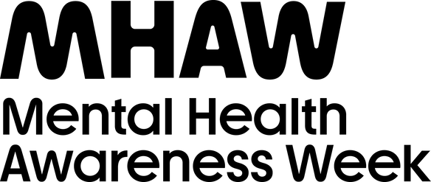
COMMUNITY IS...
WHAT WE CREATE
together.
Quiz
mhaw.nz

Slide 2
The Mental Health Foundation of New Zealand (MHF)
has been running Mental Health Awareness Week (MHAW)
in Aotearoa since:
A. 2012
B. 1993
C. 2004
Q1

Slide 3
True or false:
According to research carried out to understand
the impact of extreme weather events on wellbeing,
community was identified as the key to getting through tough times.
Q2

Slide 4
True or false:
Although they're not currently scientifically backed,
the Five Ways to Wellbeing are a set of actions known
to boost our mental health.
Q3

Slide 5
Name all Five Ways to Wellbeing.
Bonus point for using Te Reo Māori.
Q4

Slide 6
What proportion of people have felt lonely
at least some of the time in the past two weeks?
A: Nine ten
B: One in ten
C: Four in ten
Q5

Slide 7
What is Te Whare Tapa Whā?
Q6

Slide 8
According to Te Whare Tapa Whā,
what are the four walls that hold up the wharenui?​
Q7

Slide 9
How many people will experience
mental illness and/or addiction this year?
A: Three in five
B: One in five
C: Two in five
Q8

Slide 10
True or False:
Mental wellbeing refers to the state of being happy all the time.
Q9

Slide 11
True or False:
MHAW is marked by approximately 75 countries each year.
Q10

Slide 12
Mental Health Awareness Week is for:
A: Schools and workplaces
B: Community groups
C: Whānau
D: All of the above
Q11

Slide 13
True or False:
Strong social connections are essential
for life satisfaction and health.
Q12

Slide 14
Answers
1. B - The MHF has been running MHAW in Aotearoa since 1993
2. True – The MHF commissioned research to understand the impact of Cyclone Gabrielle and other extreme weather events on wellbeing. Over 1,500 people from affected regions revealed a clear theme: community is the key to getting through tough times.
3. False - The Five Ways to Wellbeing are backed by evidence and can be easily incorporated into anyone's life.
4. The Five Ways to Wellbeing are:
    Take notice – Give – Be Active – Connect – Keep Learning
    Me aro tonu – Tukua – Me kori tonu – Me whakawhanaunga – Me ako tonu ​

Slide 15
Answers
5. C - Four in ten people have felt lonely at least some of the time in the past two weeks, according to research commissioned by MHF to understand the impacts of Cyclone Gabrielle and other extreme weather events of 2023. Find more information here.
6. Te Whare Tapa Whā was developed by leading Māori health advocate and researcher Tā Mason Durie in 1984, to provide a Te Ao Māori perspective on wellbeing. Te Whare Tapa Whā is a holistic model of health that describes health as a wharenui/meeting house with four walls, with our connection with the whenua/land forming the foundation. Find more about Te Whare Tapa Whā here.
7. The four walls of the wharenui represent taha wairua (spiritual wellbeing), taha hinengaro (mental and emotional wellbeing), taha tinana (physical wellbeing) and taha whānau (family and social wellbeing). ​Our connection with the whenua/land forms the foundation.

Slide 16
Answers
8. B - At least one in five New Zealanders live with mental illness and/or addiction each year. Find more information here.
9. False - We all have mental health. It’s a taonga/treasure, something to look after so we can lead our best and most fulfilling lives. Mental wellbeing encompasses feeling good about oneself, managing emotions, coping with stress, and having a sense of purpose and fulfillment.
10. False - MHAW is marked in over 150 countries at different times of the year.
11. D - All of the above! MHAW is for schools, workplaces, community groups, whānau, individuals and anyone else who would like to participate.
12. True - Research shows that strong social connections are essential for life satisfaction and health.

