Slide 1
Minimising and managing workplace stress

Slide 2
Karakia
Whakataka te hau ki te uru, Whakataka te hau ki te tonga. Kia mākinakina ki uta, Kia mātaratara ki tai. E hī ake ana te atākura, He tio, he huka, he hauhunga. Haumi e! Hui e! Tāiki e!
Get ready for the westerly and be prepared for the southerly. It will be icy-cold inland, and icy-cold on the shore. May the dawn rise red-tipped on ice, on snow, on frost. Join! Gather! Intertwine!

Slide 3
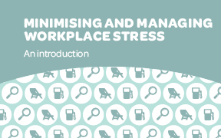
This resource will help you

Slide 4
What the presentation covers

Slide 5
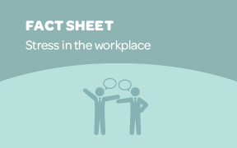
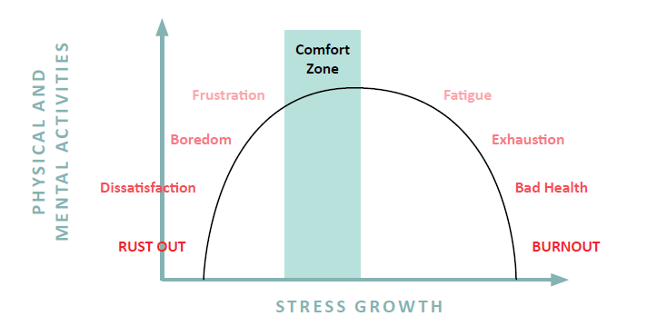
Stress and productivity at work
Karmakar, R. (2017). Guidelines for stress management. Psychology and Behavioral Science International Journal, 3(2): 555607. DOI: 10.19080/PBSIJ.2017.03.555607.

Slide 6
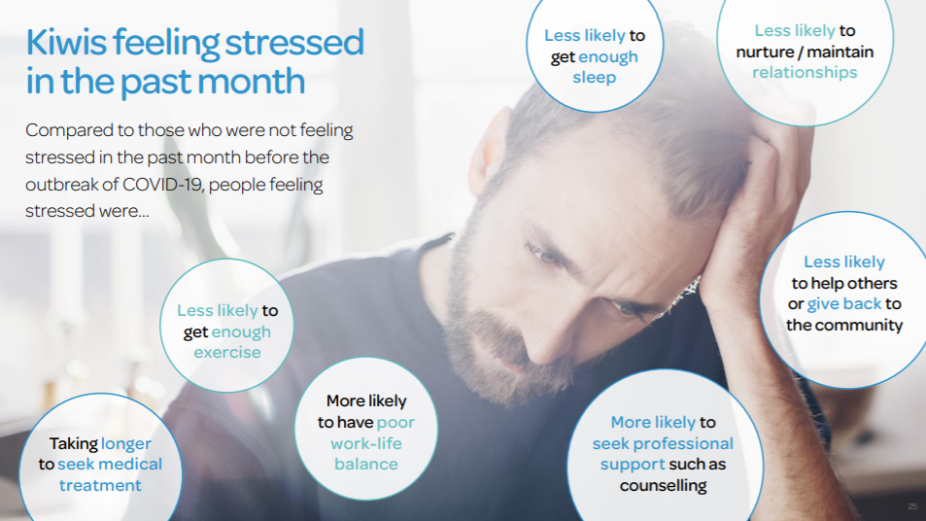

Slide 7
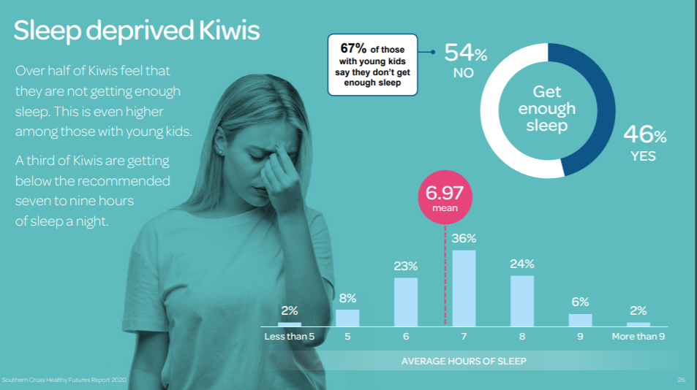

Slide 8
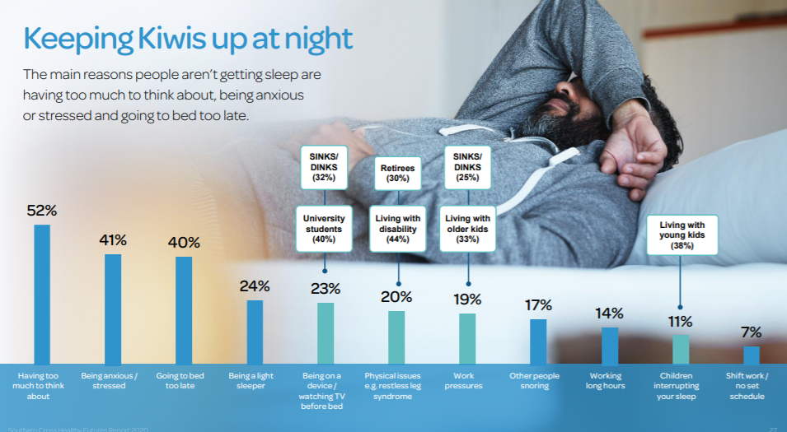

Slide 9
Signs for stress at work

Slide 10
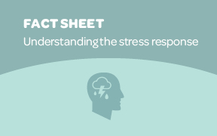
Understanding the stress response
Stress is normal. It is our bodies’ response to help us prepare for challenges
In today’s world we face many situations that can trigger our stress response
We need to make sure we turn off and recover, this is particularly important as many more people work from home
Too much stress can be harmful and can lead to burnout
In small doses, experiencing stress can help us to perform
Workplace processes and systems can support minimising, managing and recovering from stress

Slide 11
Understanding burnout
In May 2019, the World Health Organization (WHO) formally recognized burnout as an “occupational phenomenon”
Burnout can be defined as the loss of meaning in one’s work, coupled with mental, emotional, or physical exhaustion as the result of long-term, unresolved stress
Burnout can affect well-being and quality of life in various ways. This can lead to poor physical and mental health, as well as a sense of isolation from other people. It can also contribute to a loss of pleasure in activities that used to be pleasurable

Slide 12
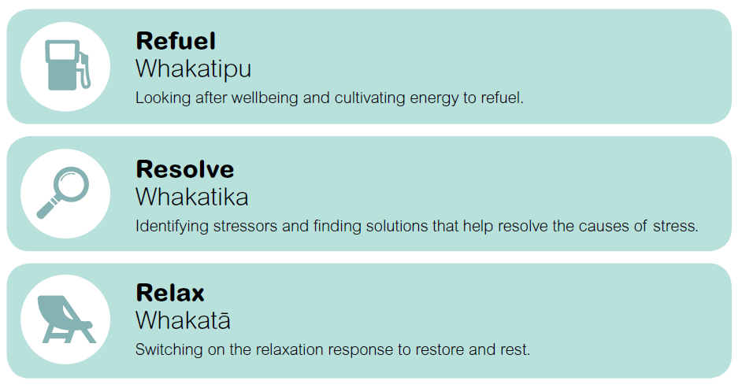
Reducing the impact of stress – the three Rs

Slide 13
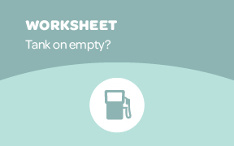
Tank on empty?
Activity
What does stress look like for me?
How do my thoughts, feelings or behaviours change when I’m stressed or not coping?

Slide 14
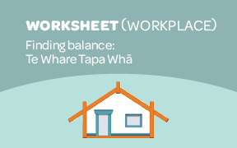
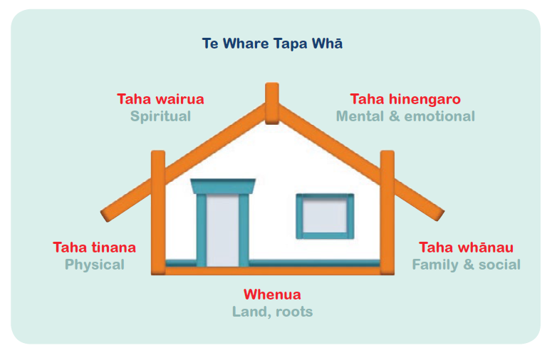
Finding balance: Te Whare Tapa Whā
Activity
We can understand our wellbeing in terms of the balance between different parts of our lives.
Using the finding balance worksheets, consider each area and what you are doing to keep each of your walls strong.

Slide 15
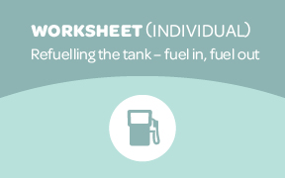
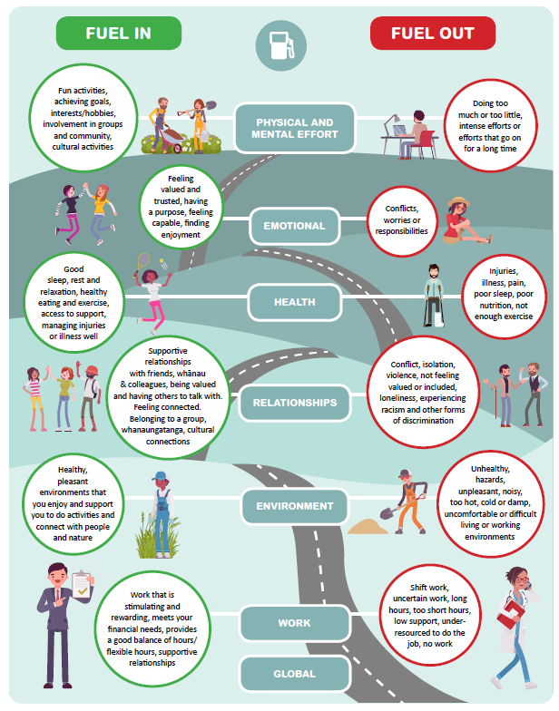
Fuel in, fuel out
We all face multiple demands on our time and energy
Keeping track of how full our wellbeing tank is allows us to manage these demands, and have space for enjoyment too
Recognising what empties our tank, and what fills it, can help us manage our journeys
Asking our team members “how are you, really?”, noticing any changes and having conversations about those changes are important

Slide 16
Checking your fuel tank level
Activity
Look at the frameworks highlighting the different aspects of life we all experience. Consider which ones impact your life, topping up or draining your tank.
Think about the last week – what things happened to fill or drain your tank?
Note down what was fuel in, and what was fuel out.
Have you got more going out than coming in?
What things did you do to help refuel?
What supports can you call on to help top you up and reduce emptying your tank?

Slide 17
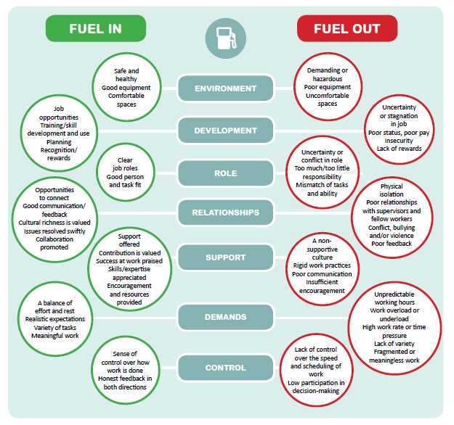
Activity
How does your workplace leadership demonstrate a commitment to eliminating or minimising stressors and their impact?
How does your workplace use systems and processes to identify and manage psychosocial risks?
How does your workplace provide opportunities for people to strengthen their skills and resiliency?
How does your workplace support workers who have been impacted by stress?
What supports and services at work and in the community could help?

Slide 18
RESOLVE Stressor – driving a truck
 | What do you see as challenging about the situation? | What are the signs for you it is a challenge?
With others (relationships) | Worry about keeping everyone and the horses safe | Feel nervous so get ready very early
Physically | It is physically demanding and tiring | Feel sick / headache / hot / frown /
Mentally | Start thinking about driving several days prior | I think about it a lot, running through the route in my head
Emotionally | Anxious | Short with my daughter
To your identity and beliefs | Very important to keep safe | Worried something might happen

Slide 19
How do we manage these challenges?
Stressor | Thoughts | Feelings | Actions
Driving a truck | Worried about getting there and back safely | Anxious | Plan the route Check the vehicle Prepare early
Difficult discussion with a colleague | They might think I am being difficult | Sad | Prepare what I want to say and what questions. Think about where, when and how.

Slide 20
Thinking about our thoughts
Do I know the facts, or am I guessing what other people think or mean?
Am I jumping to conclusions about the results of a situation?
Do I often assume the worst, or think about things in ‘always’ or ‘never’ terms?
Am I blowing the outcomes and impacts out of proportion?
Have I looked at times I have succeeded, or only considered my failures?
Am I taking responsibility for something that isn’t in my control (e.g., other people’s actions)?
Do I automatically think I can’t do this, I won’t know how, or I won’t get it right?

Slide 21
Identifying what we find challenging about situations and how we think, feel and react helps us identify what we need to work on to reduce the stress of each situation.
This worksheet will help you identify challenges, how you currently manage these situations, and how you respond (thoughts, feelings and actions).
Often a combination of both acceptance and change strategies are needed to resolve stress.
This worksheet will help you/your team come up with strategies to help accept and/or change situations that are causing stress. It provides a simple problem-solving template.

Slide 22
Working backwards to a solution
Step One: Choose a realistic time in the future when you could reasonably expect the issue would be resolved.
Step Two: Invite others to add their input into the description of the issue now that it has been resolved.
Step Three: Describe together the steps and actions that were put in place that resulted in the resolution.
Step Four: Develop and agree on how and by who action points were followed up.

Slide 23
Switching on your relaxation response
Relax | Whakatā is one of the Three Rs that allow you to reduce things that trigger your stress response. Turning on our relaxation response puts a brake on the physical changes in our body, produced by the stress response.
What has worked for you in the past?
Switching on your relaxation response helps focus your mind on thoughts or actions that feel good – interrupting stressful thoughts and feelings. This worksheet introduces breathing and muscle techniques that have been shown to be particularly helpful for relaxation.
Basic deep breathing
Guided breathing
Progressive muscle relaxation
Activity – choose one of the three activities and follow the instructions to relax.

Slide 24
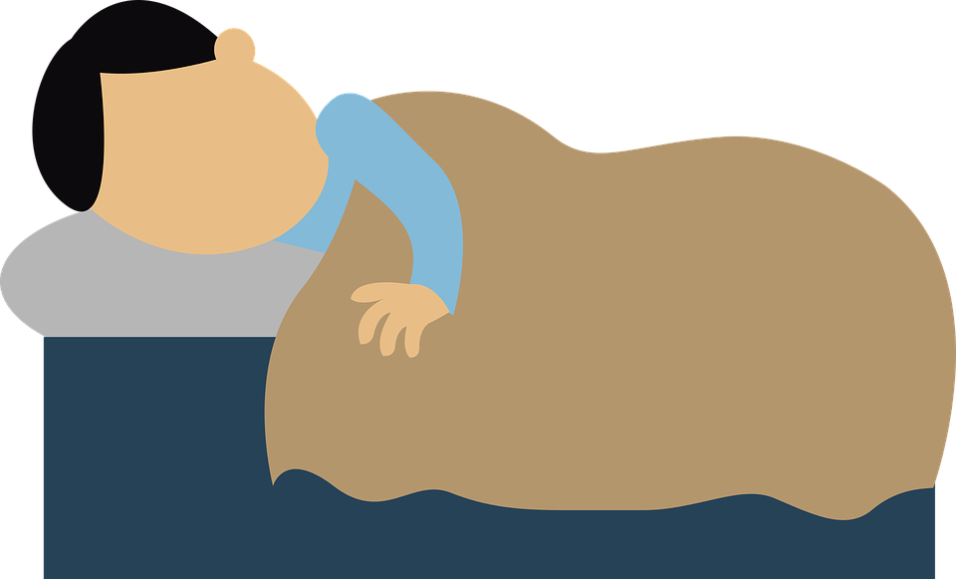
Sleep
Get some morning sunlight to promote the production of melatonin
We should prepare to sleep, not try to sleep. Trying to sleep turns on our stress response
Having a set bedtime signals to your body it is nearly sleep time
No caffeine after lunch and limit the consumption of alcohol
Turn off all screens including the TV at least an hour prior to bed
Do the dishes, tidy up, turn the lights down, pull the curtains, shower, hot drink, change your clothes etc
If you don’t drift off within 20-30 minutes, get up until you feel sleepy again. Keep the lights low and do something that is not stimulating your brain

Slide 26
Getting help and advice
There are a range of other resources to support mental wellbeing in the workplace and help people and workplaces minimise and manage stress. This fact sheet highlights where you can access further support for yourself or your people.
Workplace support and resources
Support to refuel your tank | Whakatipu ake noa
Support to resolve causes of stress | Whakatika ngā raruraru
Support to switch on the relaxation response | Whakatā tō waiora
Phone support
Directories to find local services

Slide 27
Mental Health Foundation Covid-19 resources
https://mentalhealth.org.nz/search?query=covid

Slide 28
